Slide 1

Design Studio Workshop
Will Evans | @SemanticWill

Slide 2
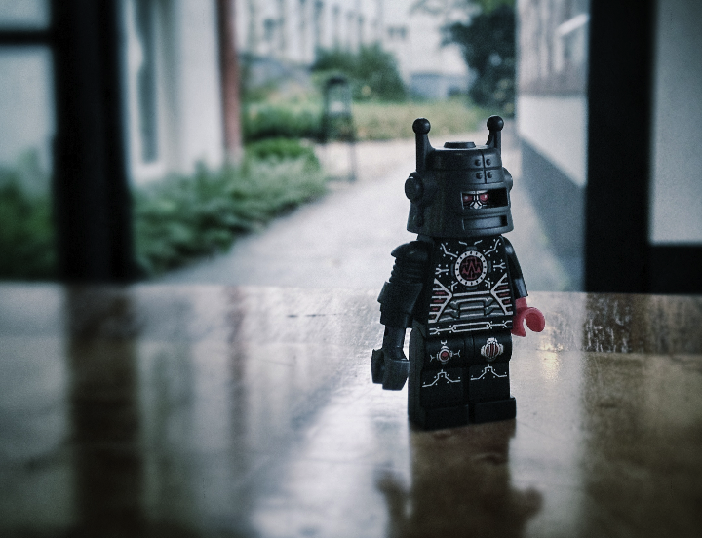
#DSNL12
You can use this hashtag to tweet about this.

Slide 3
Introduction to Design Studio
Will Evans | @semanticwill

Slide 4

Who are you?
Will Evans | @semanticwill

Slide 5


Slide 6

It starts with a problem statement.

Slide 7
4 C

Slide 8
Components
Characteristics
Challenges
Characters

Slide 9
Components
Components are parts of the topic. For example, a component of a web-scale knowledge platform for a community of practice might be a piece of media or a reputation score

Slide 10
Characteristics
Characteristics are features of the topic. For example, publishing new media is characterized by a “power-law”

Slide 11
Challenges
Challenges are obstacles associated with the topic. For example, finding credible mentors or experts within a community of practice is difficult

Slide 12
Characters
Characters are people associated with the topic. Customers, Stakeholders, Partners, Internal Collaborators

Slide 13
Problem Statement

Slide 14
Background
300,000 books were published in the U.S.2003
411,422 books were published in the U.S. in 2007
1,052,803 books were published in the U.S. 2009
3,000,000 books were published in the U.S. in 2011.

Slide 16
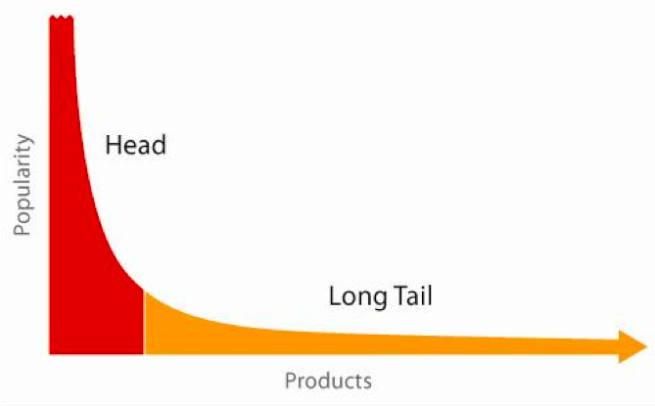

Slide 17
Background
The traditional value of publishing house, journals was curated, edited, experience.
These channels provided a framework and language for the critique of ideas.
Due to proliferation of electronic readers, media, lightweight publishing platforms have made it insanely easy to publish junk.

Slide 18
Background
We’re experiencing a power-law of proliferation of self-published media – but how do I find valuable, credible material?
Traditional ontologies are brittle; as the volume of media increases, cataloguing becomes more difficult.
Classification is a problem (Dewey doesn’t scale)
Expertise/Authority is a problem (How do I find good stuff)
Authorship problem: how do authors find new communities of practice to sell into?

Slide 19
Problem Statement
For professionals in a community of practice, we face 3 problems:
Professionals need to learn to improve their skills
Mentorship is not a very scalable model
How do you know what the "right" things to read are?
How does a community of practice curate and critique authors and experts?

Slide 20
Components
Characteristics
Problem Statement
Challenges
Characters

Slide 21
Components
Characteristics
3.10.3
Challenges
Characters

Slide 22
Design Studio

Slide 23
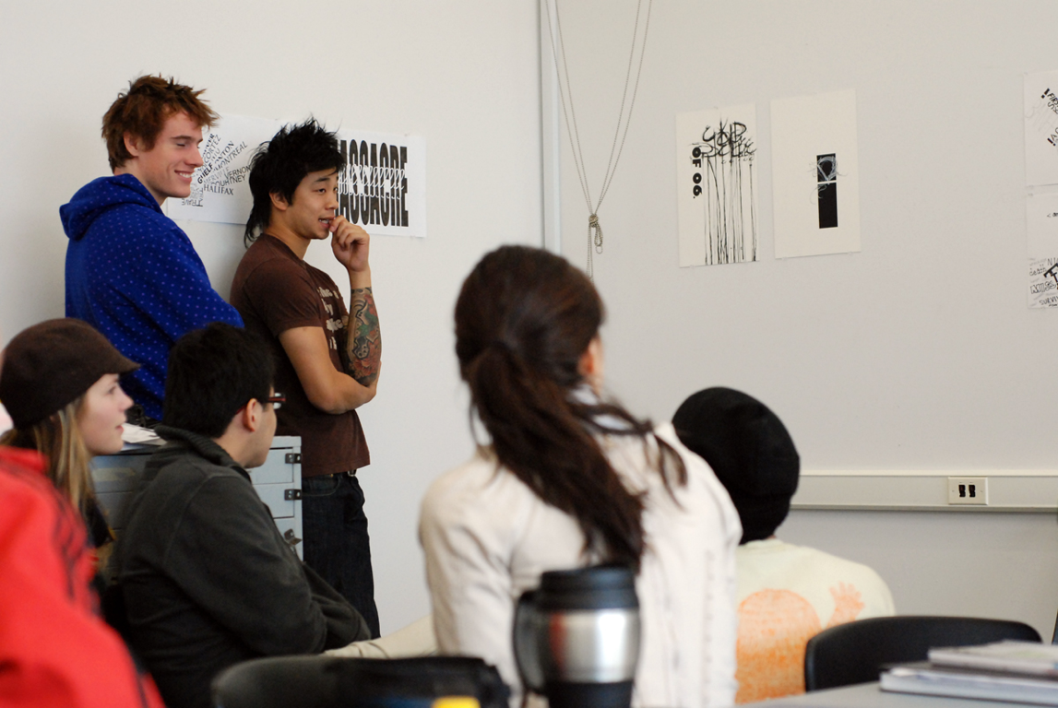

Slide 24
Create. Pitch. Critique. TECHNICALLY THIS IS CALLED A CHARRETTE.

Slide 25
Level playing field. Idea generation. Team buy-in. Ownership/investment. Vet design concepts.
Notes:
It’s a level playing field. Everyone gets the same tool—paper and sharpies. No PS for designers. No code for developers. No PPT for business people. Everyone’s on the same field.

Slide 26
6.8.5
Notes:
This is my version. I call it the 685.

Slide 27
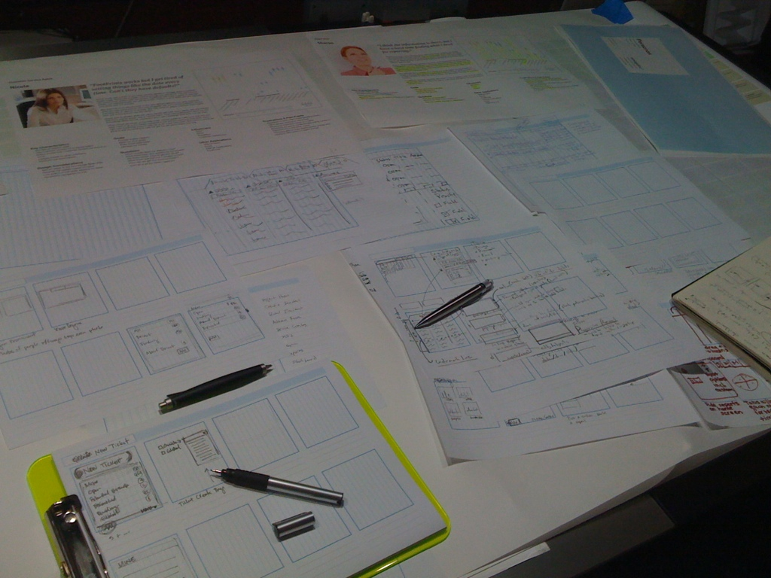
Notes:
TOOLS:
A design challenge
Paper/sketch templates
Sharpies
Personas
Inspiration library
Some groovy music

Slide 28

Notes:
Oh and a stop watch/timer.
Very important.

Slide 29
Create. Pitch. Critique.

Slide 30
Create six to eight concept sketches individually.

Slide 31

Notes:
6-8 sketches.
Get it down fast, just enough to tell your story, then move on.

Slide 32
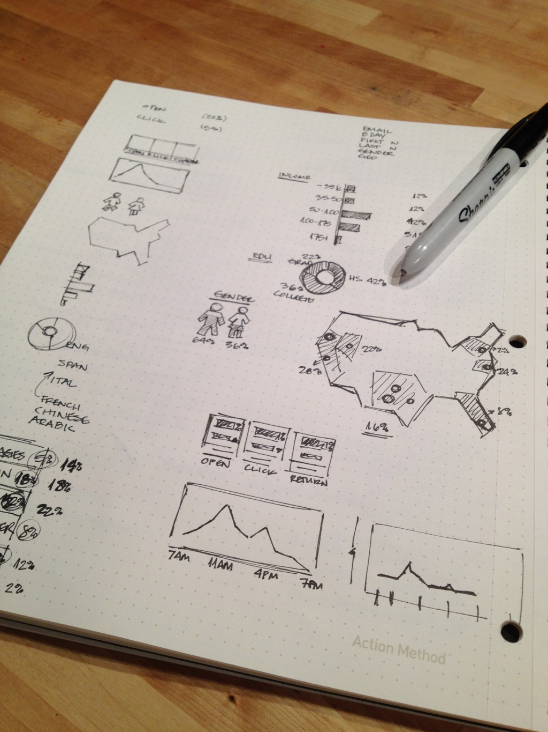
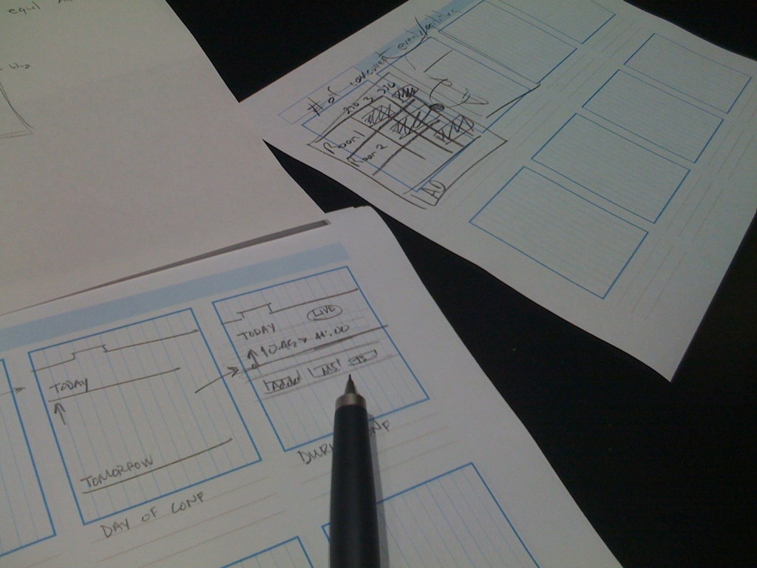
Line, Square, Circle, Triangle
Notes:
Just enough to tell the story.

Slide 33
Focus on the bare minimum to convey your concept
Notes:
Just enough to tell the story.

Slide 34
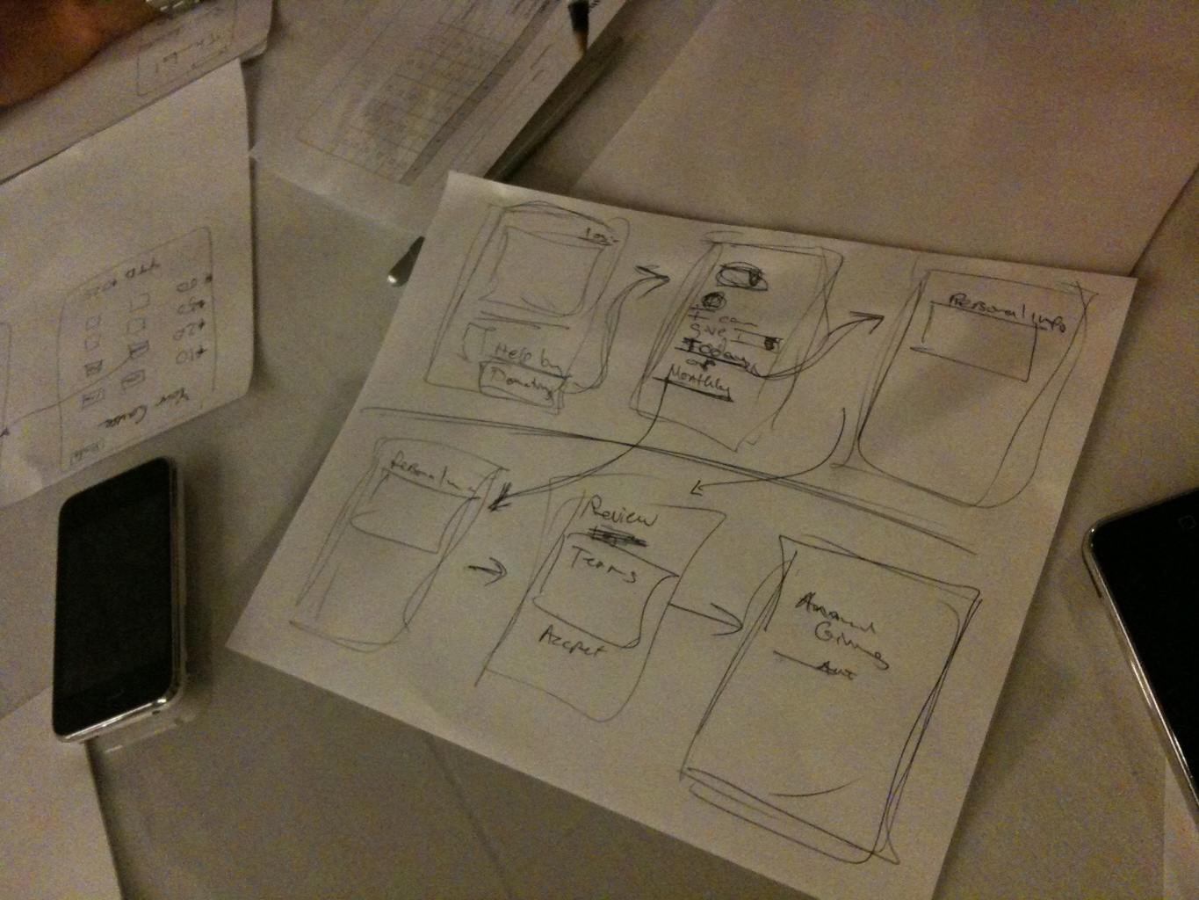
All ideas must map to Russell’s goals & needs.
Notes:
Just enough to tell the story.

Slide 35
Create. Pitch. Critique.

Slide 36
Three minutes to pitch how your concept solves the problem.

Slide 37
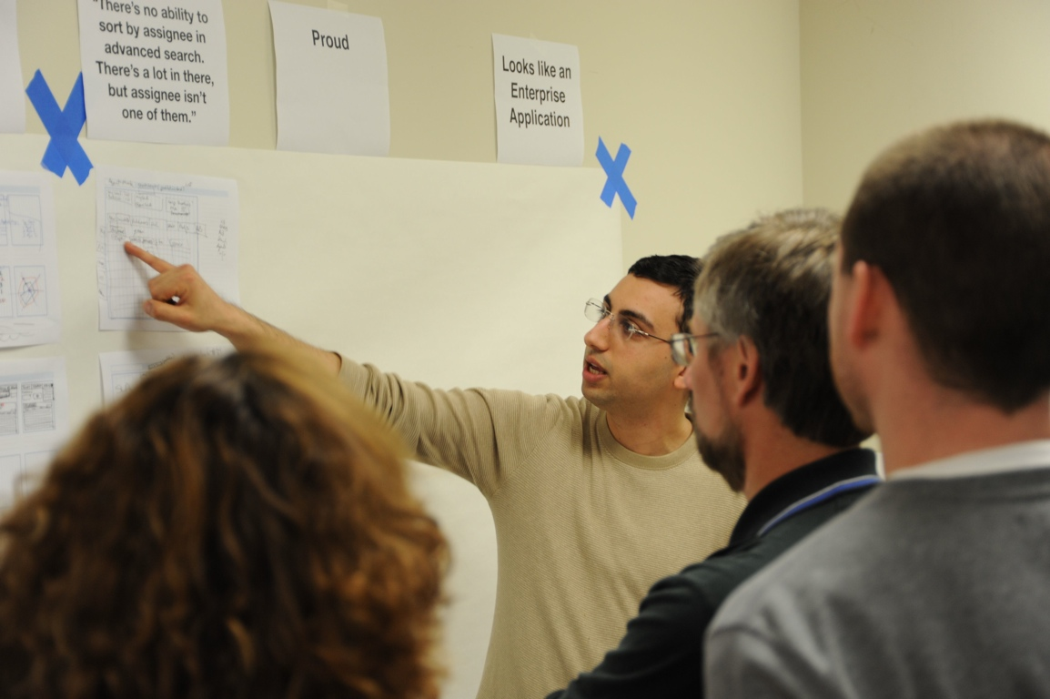

Slide 38
Create. Pitch. Critique.

Slide 39
Two minutes for critique.

Slide 40
Two to three ways it solves the problem and one to two opportunities to improve.

Slide 41
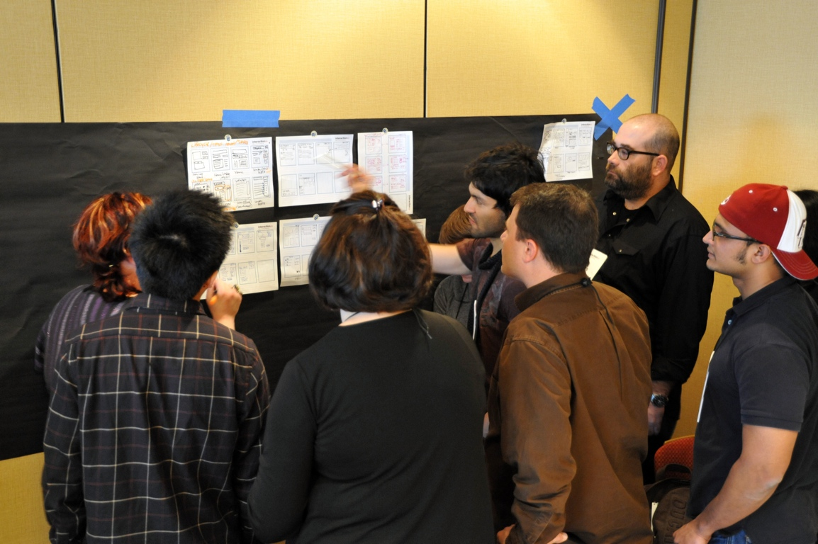

Slide 42
Iterate as a team based on the critique. Then pitch and critique with another team.

Slide 43
6.8.5
Notes:
Oh, about that five part.

Slide 44
5 minutes
Notes:
Five minutes to create those 6-8 sketches. Save it for the end, right before you start the clock. Sheer panic sets in and they don’t have any time to think about it. Just do.

Slide 45
Let’s do this!

Slide 46
Sketching
5 minutes

Slide 47
Pitching
3 minutes

Slide 48
Critique
2 minutes

Slide 49
2nd Iteration
6.8.5

Slide 50
Group Sketch
1 Concept
25 minutes

Slide 51
Present
Pick a spokeperson
5 minutes to present

Slide 52
Team Critique
2 X 2

Slide 53
Ritual Dissent
The basic approach involves a spokesperson presenting a series of ideas to a group who receives them in silence.

Slide 54
Ritual Dissent
The spokesperson turns to face the wall, so that their back is to the audience and listens in silence while the group attacks the idea.
The spokesperson cannot respond to questions or defend the ideas.

Slide 55
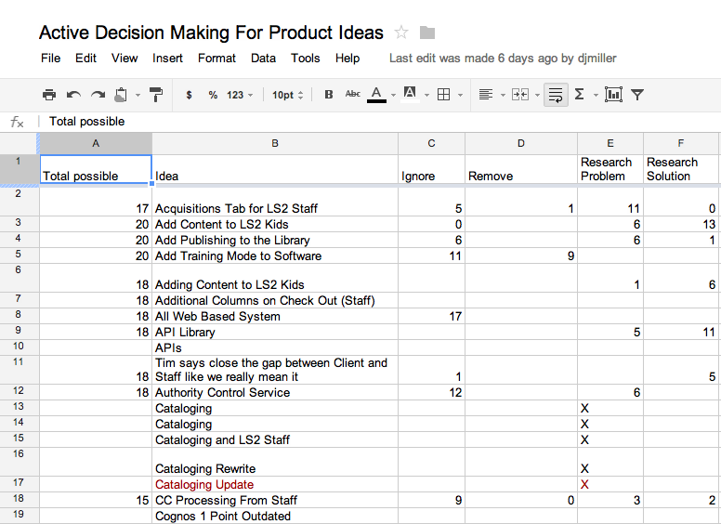
Active Decision Making Model

Slide 57
For all critique decide:
Ignore
Research Problem
Research Solution
Best Practice

Slide 58
Thanks!
Will Evans | @SemanticWill
Jabe Bloom | @Cyetain
tlclabs.co

